Slide 1
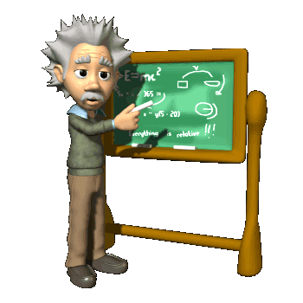
Chapter 2
Differentiation (微分)
In this Chapter, we will know some important concepts.
The Derivative (导数)
The Chain Rule (链锁法则)
Implicit Differentiation (隐函数求导)
The Mean Value Theorem (中值定理)

Slide 2
Section 2.1 Tangent Lines (切线) and Velocity
Calculus is the mathematics of change, and the primary tool for studying change is a procedure called differentiation.
In this section, we will introduce this procedure and examine some of its uses, especially in computing rates of change.
Rate of changes, for example velocity, acceleration, the rate of growth of a population, and many others, are described mathematically by derivatives.

Slide 3
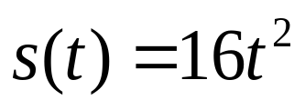
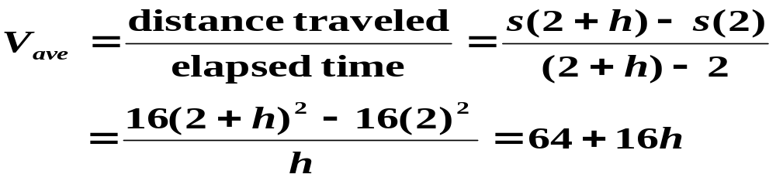

Example
If air resistance is neglected, an object dropped from a
great height will fall feet in t seconds. What is the object’s instantaneous velocity after t=2 seconds?
Solution:
Average rate of change of s(t) over the time period [2,2+h] by the ratio
Compute the instantaneous velocity by the limit
That is, after 2 seconds, the object is traveling at the rate of 64 feet per second.

Slide 4
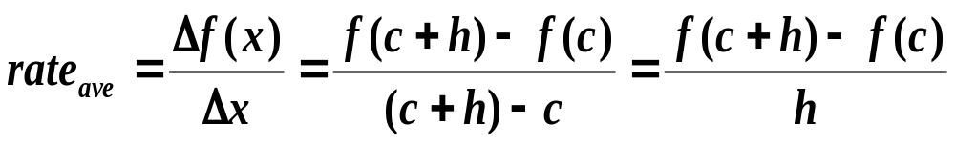
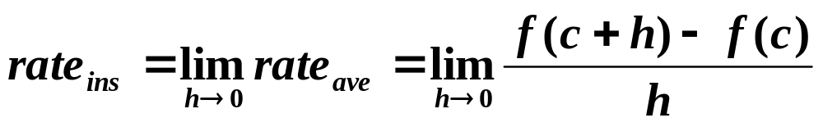
Rates of Change （变化率）
How to determine instantaneous rate of change or rate
of change of f(x) at x=c ?
Find the average rate of change of f(x) as x varies from x=c to x=c+h
Compute the instantaneous rate of change of f(x) at x=c by
finding the limiting value of the average rate as h tends to 0

Slide 5
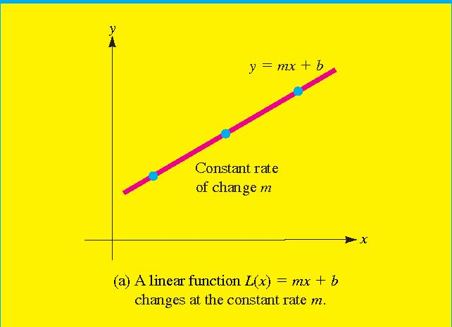
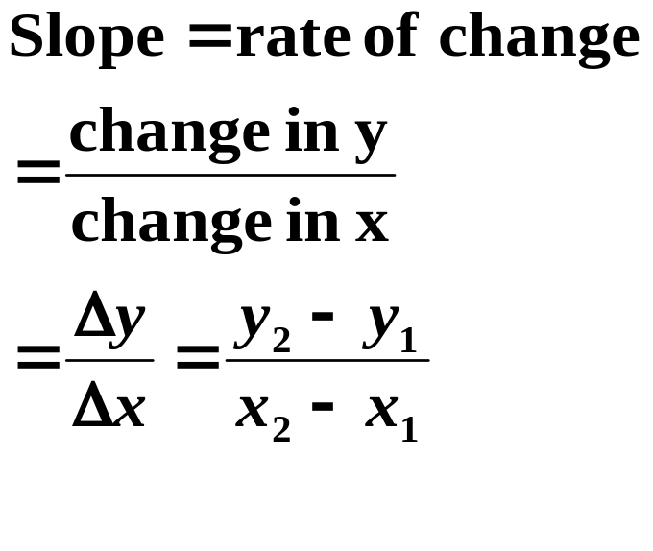
Rates of Change (Linear function)
A linear function y(x)=mx+b changes at the constant rate m
with respect to the independent variable x. That is the rate of
change of y(x) is given by the slope or steepness of its graph

Slide 6
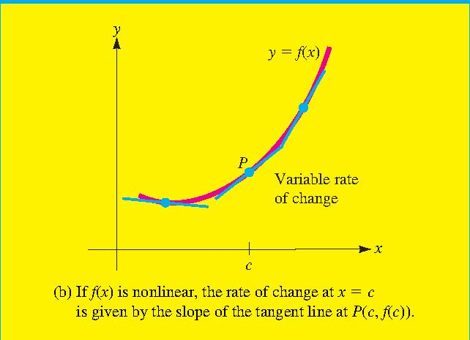
Rates of Change (non-Linear function)
For the function that is nonlinear, the rate of change is not constant but varies with x.
In particular, the rate of change at x=c is given by the steepness of the graph of f(x) at the point (c,f(c)), which can be measured by the slope of the tangent line to the graph at p.

Slide 7

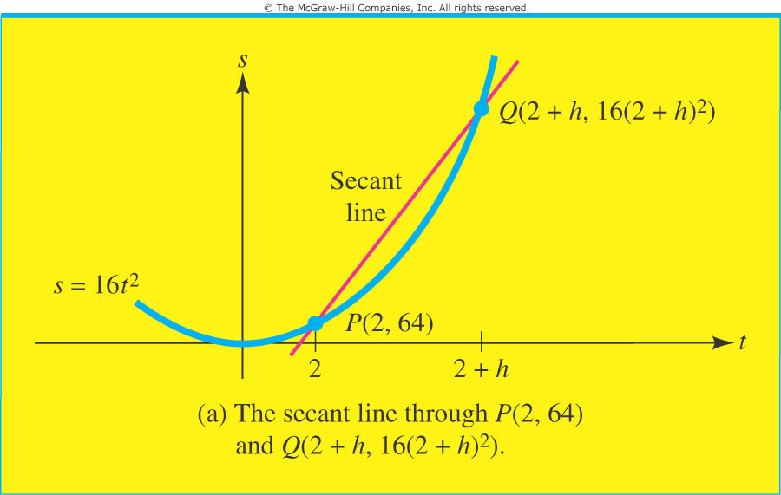
The slope of secant line （割线的斜率）
The secant line: A line that intersects the curve at the point
x and point x+h
The average rate of change can be interpreted geometrically as the slope of the secant line from the point (x,f(x)) to the point (x+h,f(x+h)).

Slide 8
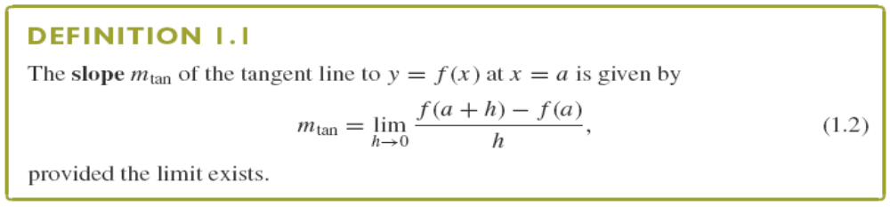
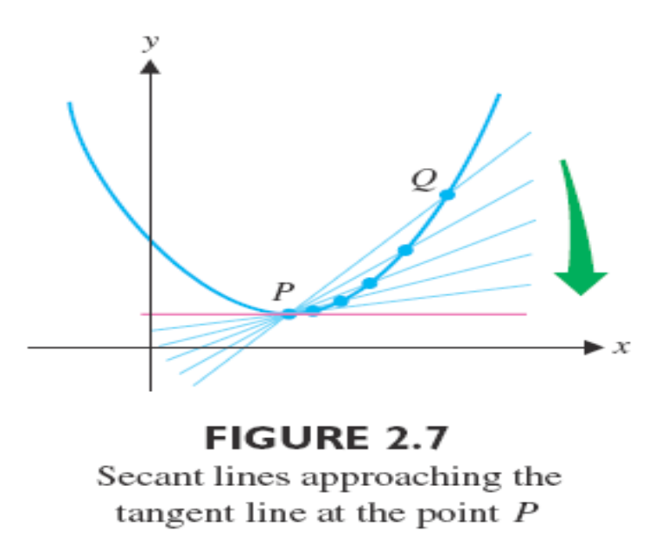
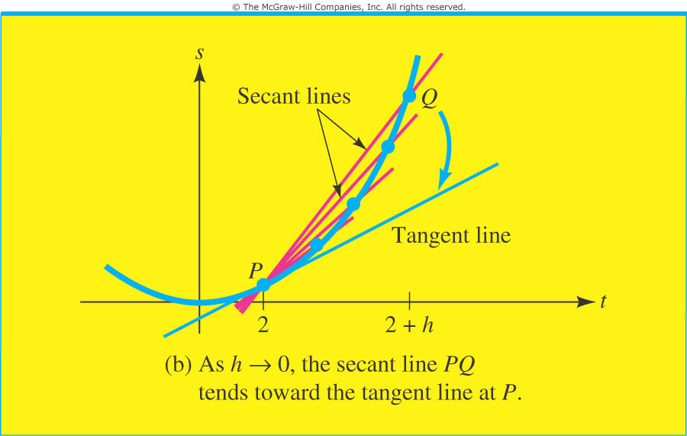
The slope of tangent line（切线的斜率）

Slide 9
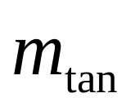
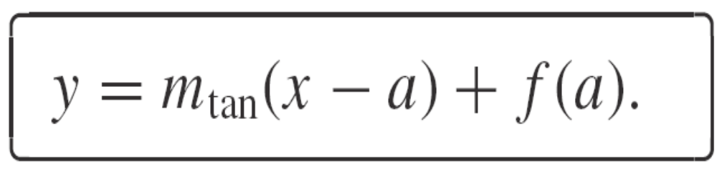
The Tangent line is then the line passing through the point (a,f(a)) with slope and so, the point-slope form of the equation of the tangent line is

Slide 10
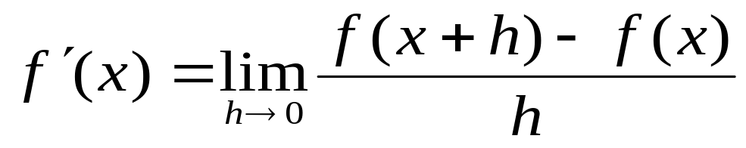
Section 2.2 The Derivative (导数)
The Derivative of a Function: The derivative of the function f(x) with respect to x is the function f’(x) given by
The process of computing the derivative is called differentiation. f(x) is differentiable at x=c if f’(x) exists

Slide 11
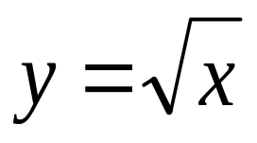
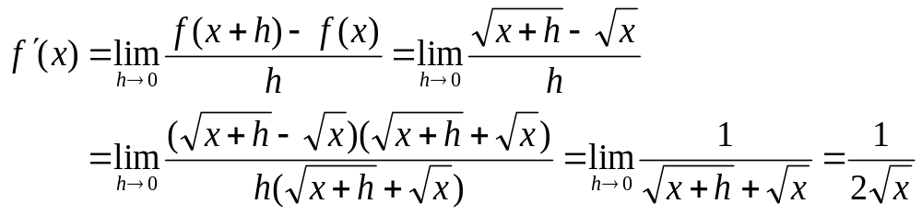
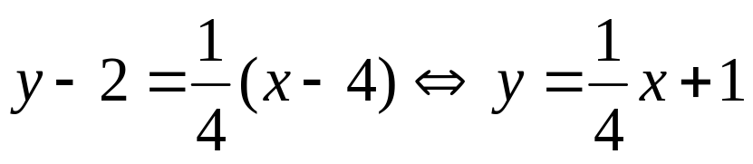
Example
What is the equation of the tangent line to the curve
at the point where x=4 ?
Solution:
According to the definition of derivative, we have
Thus, the slope of the tangent line to the curve at the point where x=4 is f’(4)=1/4 . So the point-slope form is

Slide 12
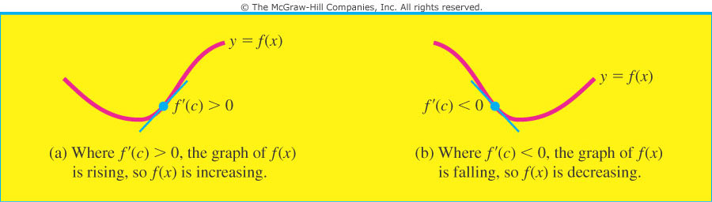
Significance of the Sign of the derivative f’(x): If the function f is differentiable at x=c, then
f is increasing at x=c if f’(c)>0 and
f is decreasing at x=c if f’(c)<0

Slide 13
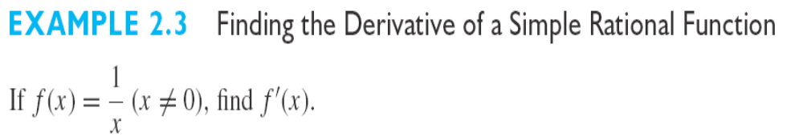
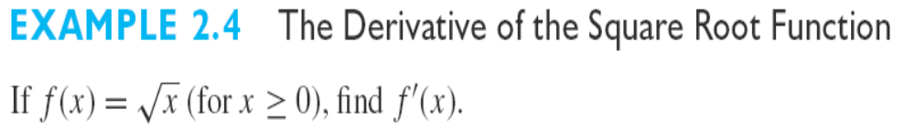

Slide 14


Alternative Derivative Notation
Given a function y=f(x) all of the following are equivalent
and represent the derivative of f(x) with respect to x.
If we want to evaluate the derivative at x=a all of the following are equivalent

Slide 15
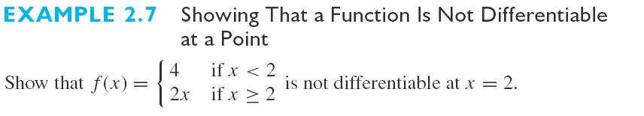
Differentiability and Continuity
Continuity of a Differentiable Function: If the function f(x) is differentiable at x=c, then it is also continuous at x=c.
Notice that a continuous function may not be differentiable

Slide 16
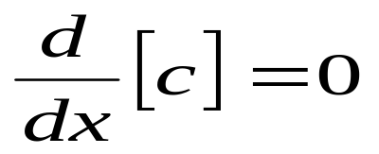
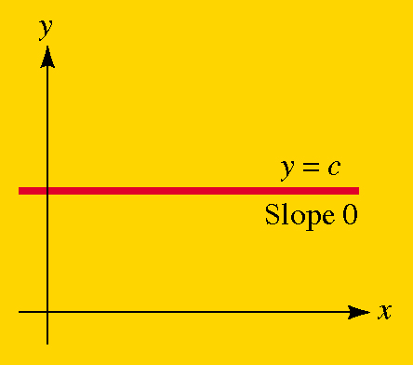
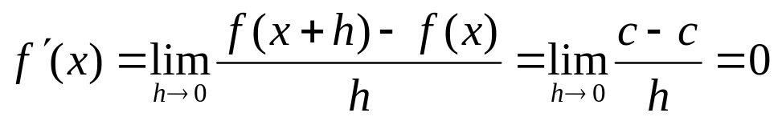

Section 2.3 Techniques of Differentiation
The Constant Rule: For any constant c, we have
That is, the derivative of a constant is zero
Proof:
Since f(x+h)=c for all x

Slide 17
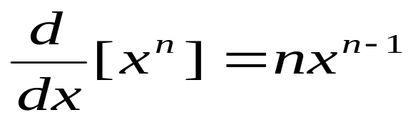
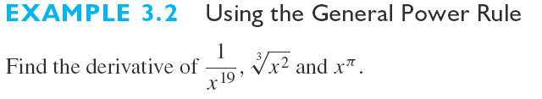
The General Power Rule For any real number n
In words, to find the derivative of x^{n}, reduce the
exponent n of x by 1 and multiply your new power
of x by original exponent.

Slide 18
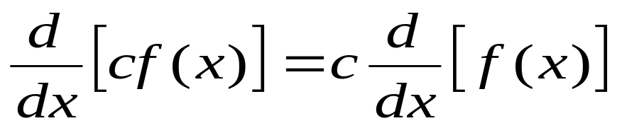
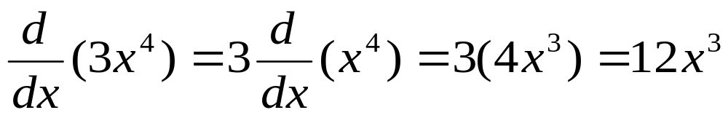
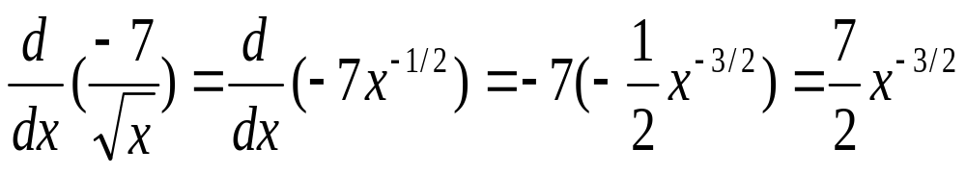
The constant Multiple Rule If c is a constant and f(x)
is differentiable then so is cf(x) and
That is, the derivative of a multiple is the multiple of the derivative
For Example

Slide 19
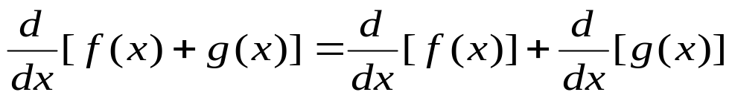
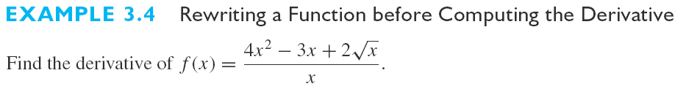
The Sum Rule: If f(x) and g(x) are differentiable then so is the sum of s(x)=f(x)+g(x) and
That is, the derivative of a sum is the sum of the separate derivative

Slide 20
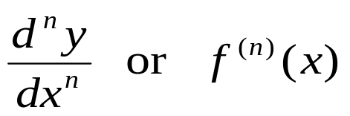
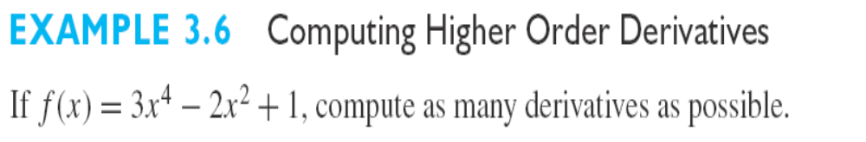
Higher Order Derivatives(高阶导数)
The nth Derivative: For any positive integer n, the nth derivative of a function is obtained from the function by differentiating successively n times. If the original function is y=f(x) the nth derivative is denoted by

Slide 21
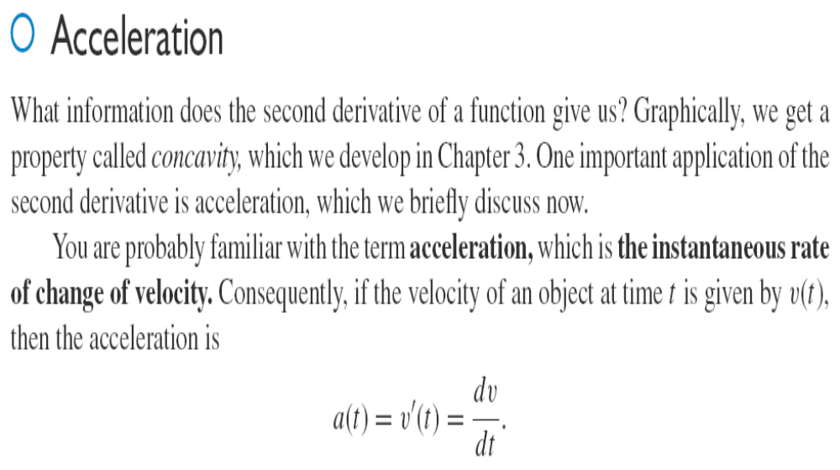

Slide 22



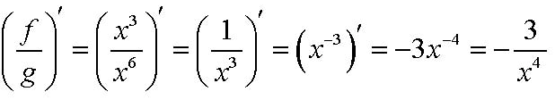
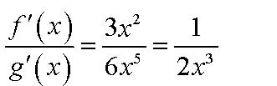
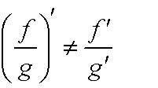
Section 2.4 The Product and Quotient Rules(乘法和除法准则)
The derivative of a product of functions is not the product of separate derivative!! Similarly, the derivative of a quotient of functions is not the quotient of separate derivative.
Suppose we have two function f(x)=x³ and g(x)=x⁶

Slide 23
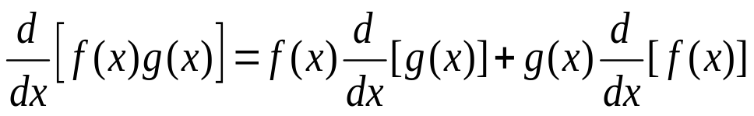

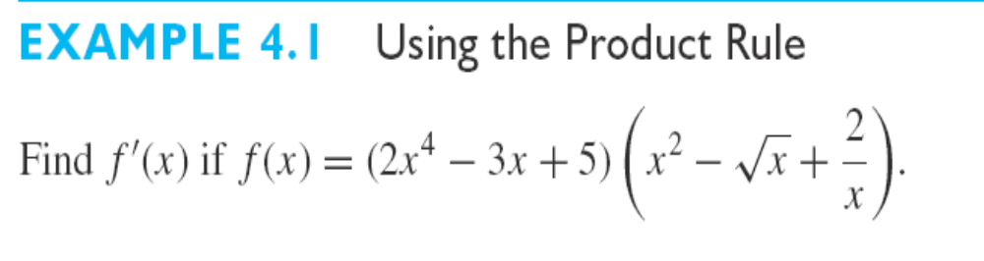
The Product Rule If the two functions f(x) and g(x)
are differentiable at x, then we have the derivative of the
product P(x)=f(x)g(x) is
or equivalently,

Slide 24
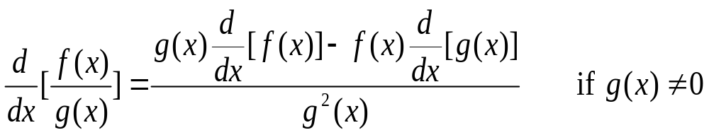
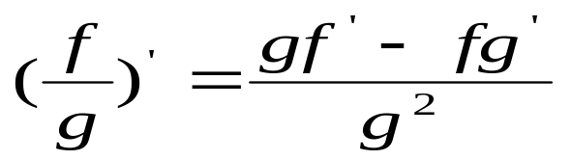
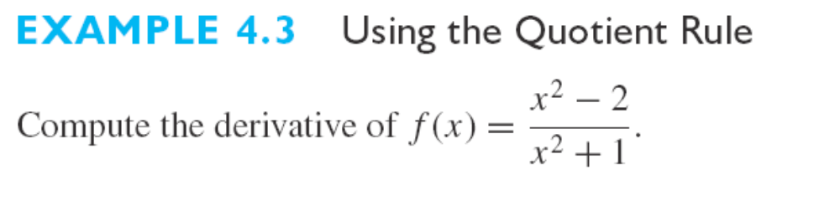
The Quotient Rule If the two functions f(x) and g(x) are differentiable at x, then the derivative of the quotient Q(x)=f(x)/g(x) is given by
or equivalently,

Slide 25
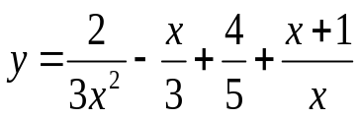
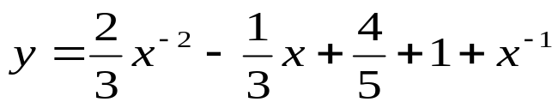
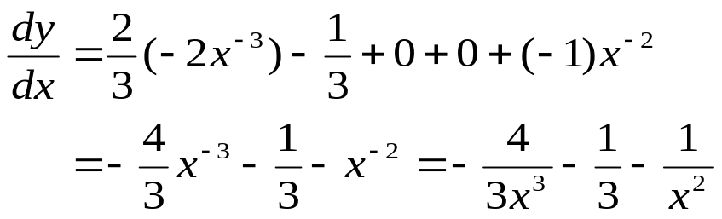
A Word of Advice: The quotient rule is somewhat cumbersome, so don’t use it unnecessarily.
Example
Differentiate the function .
Solution:
Don’t use the quotient rule! Instead, rewrite the function as
and then apply the power rule term by term to get

Slide 26
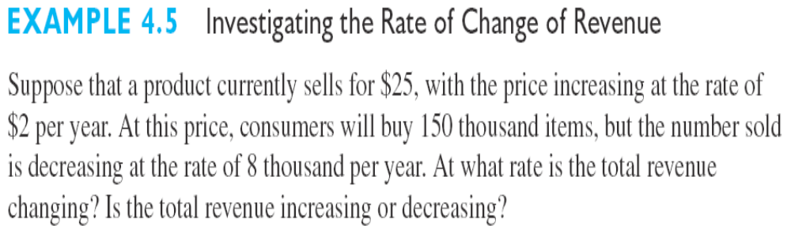
Applications

Slide 27
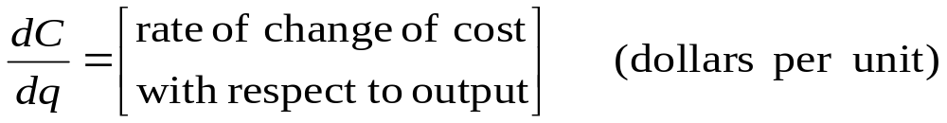
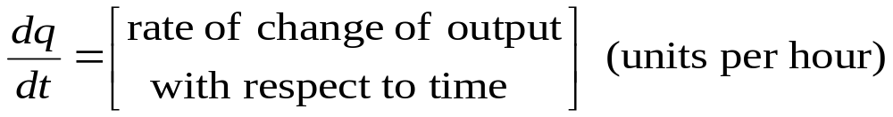
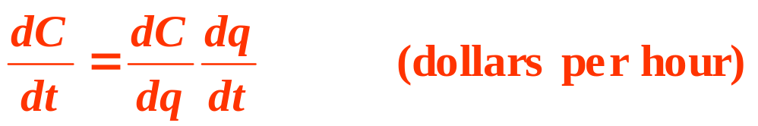
Section 2.5 The Chain Rules(链锁准则)
Suppose the total manufacturing cost at a certain factory is a function of the number of units produced, which in turn is a function of the number of hours the factory has been operating. If C, q, t, denote the cost, units produced and time respectively, then
The product of these two rates is the rate of change of cost with respect to time that is

Slide 28


The Chain Rule: If y=f(u) is a differentiable function of u and u=g(x) is in turn a differentiable function of x, then the composite function y=f(g(x)) is a differentiable function of x whose derivative is given by the product
or, equivalently, by
Note: One way to remember the chain rule is to pretend the derivative dy/du and du/dx are quotients and to “cancel” du.

Slide 29



Slide 30



Slide 31


Section 2.6 Derivatives of Trigonometric Functions (三角函数求导)

Slide 32




Slide 33



Slide 34

The derivatives of the remaining trigonometric functions are left as exercises. The derivatives of all six trigonometric functions are summarized below.

Slide 35





Slide 36
Section 2.7 Derivatives of Exponential and Logarithmic Functions (指数函数和对数函数求导)
Exponential function: If b is a positive number other than 1 (b>0, b≠1), there is a unique function called the exponential function with base b that is defined by
f(x)=b^{x} for every real number x
NOTE: Such function can be used to describe exponential and logistic growth and a variety of other important quantities.

Slide 37





Example
Solution:

Slide 38




Figure below shows graphs of various members of the family of exponential functions
NOTE: Students often confuse the power function
with the exponential function

Slide 39




Slide 40



Slide 41

Definition: The natural exponential function is
Where
n | 10 | 100 | 1000 | 10,000 | 100,000
 | 2.59374 | 2.70481 | 2.71692 | 2.711815 | 2.71827

Slide 42



Logarithmic Functions

Slide 43

4.2 Logarithmic Functions

Slide 44


4.2 Logarithmic Functions

Slide 45



4.2 Logarithmic Functions

Slide 46



Slide 47

Taking the derivatives of some complicated functions can be simplified by using logarithms. This is called logarithmic differentiation.

Slide 48


Slide 49

You should distinguish carefully between the Power Rule , where the base is variable and the exponent is constant, and the rule for differentiating exponential functions, where the base is constant and the exponent is variable.

Slide 50



